Slide 1
List View and Remove App using android studio

Slide 2
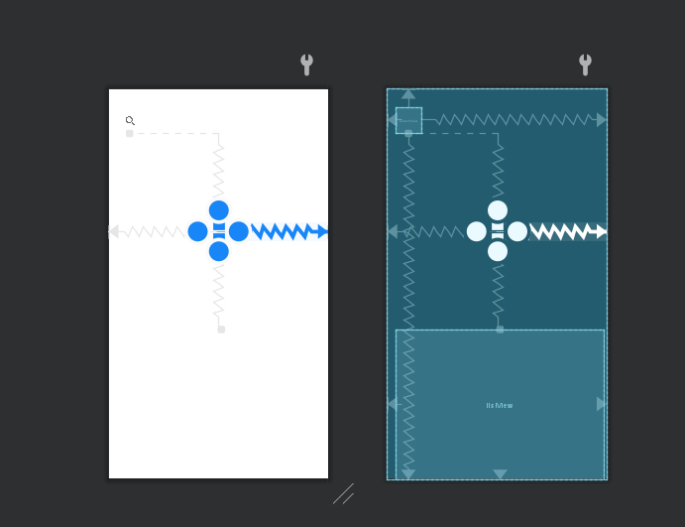
Main activity User Interface
A search Bar
Text View to display to whether the object is present in the list or not
A list View to display the objects present in the list

Slide 3
Main activity use case and My Approach
First there is a Search bar and when the user clicks the search bar icon it expands and allow user to search
When the user enter the object name and clicks search in the keyboard and there is a text view which will display whether the user entered object name is present in the list or not
Then below there is a list view with objects name , these list view are enabled with onItemClickListener and using this when the user clicks on object name it goes to another activity by using INTEND.

Slide 4
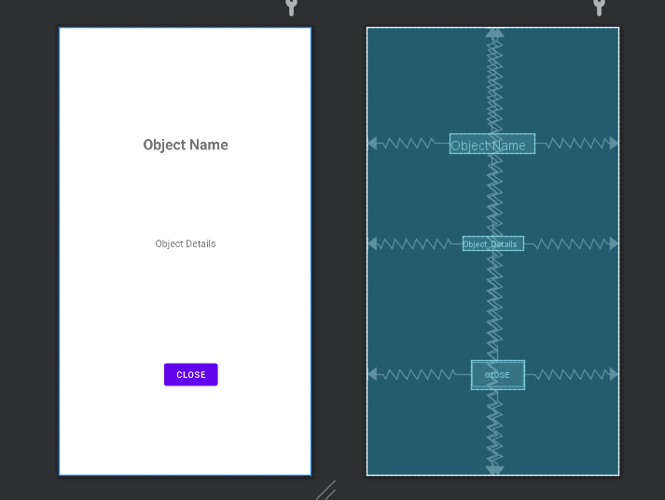
Intend Activity XML
When the user clicks on the object in the list view it intended to here
Here there is 2 text view to display object name and it details and a close Button
When the user clicks the close button it goes back to the main activity and the particular viewed object is removed from the list .

Slide 5
Key points
Enabled minimum SDK level for this app .
Generated Signed Bundle APK .
Imported the Required Dependencies .
Created a Data class for the objects to fetch and display the Information .

Slide 6
Done by S.Hari Krishnan

